Slide 1

Artificial intelligence for business
EDA and modelling notebooks
Name: Roy Uppelschoten, Rianne Noorlander, Jens Kaandorp
Date: 20-01-2022

Slide 2

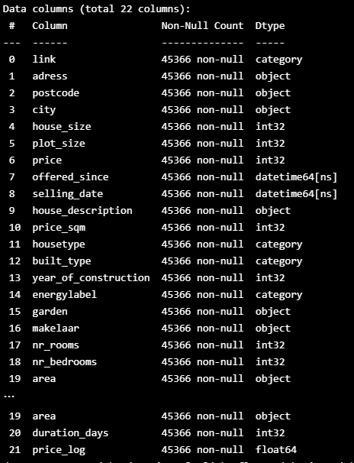
EDA notebook
We have categorised the following columns into fewer categories
Housetype, built_type and energylabel to use it in our calculations
We have added a new column ‘duration_days’ where we calculated the difference in offered_since and selling_date

Slide 3
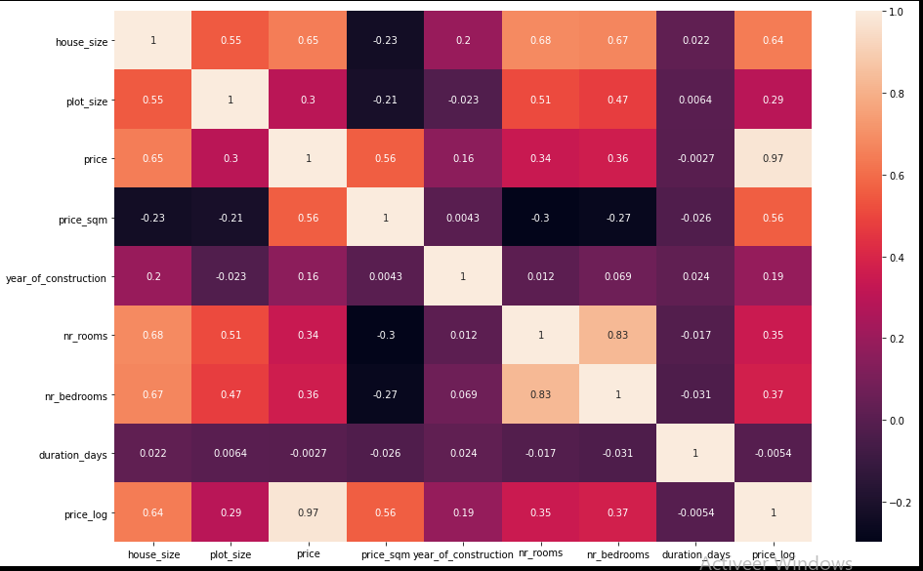
EDA notebook
Price:
Strong correlation with house_size and price_log and some with plot_size, nr_rooms and nr_bedrooms
Duration_days:
No strong correlation with one of the numerical values

Slide 4
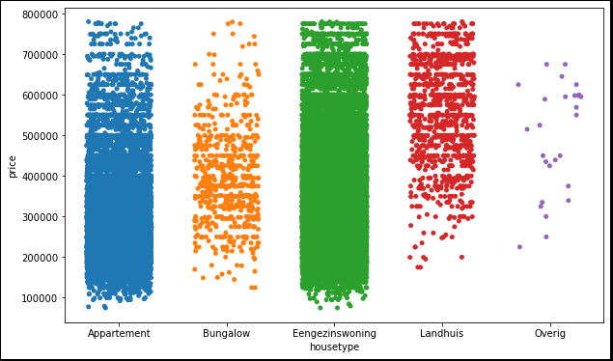
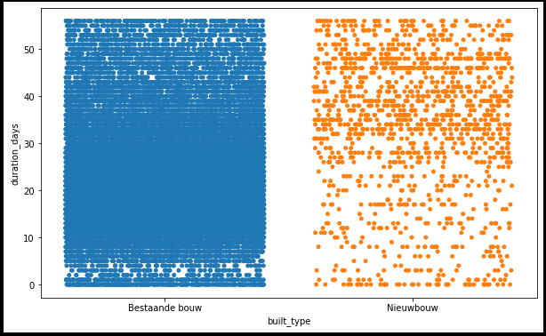
EDA categorical values

Slide 5
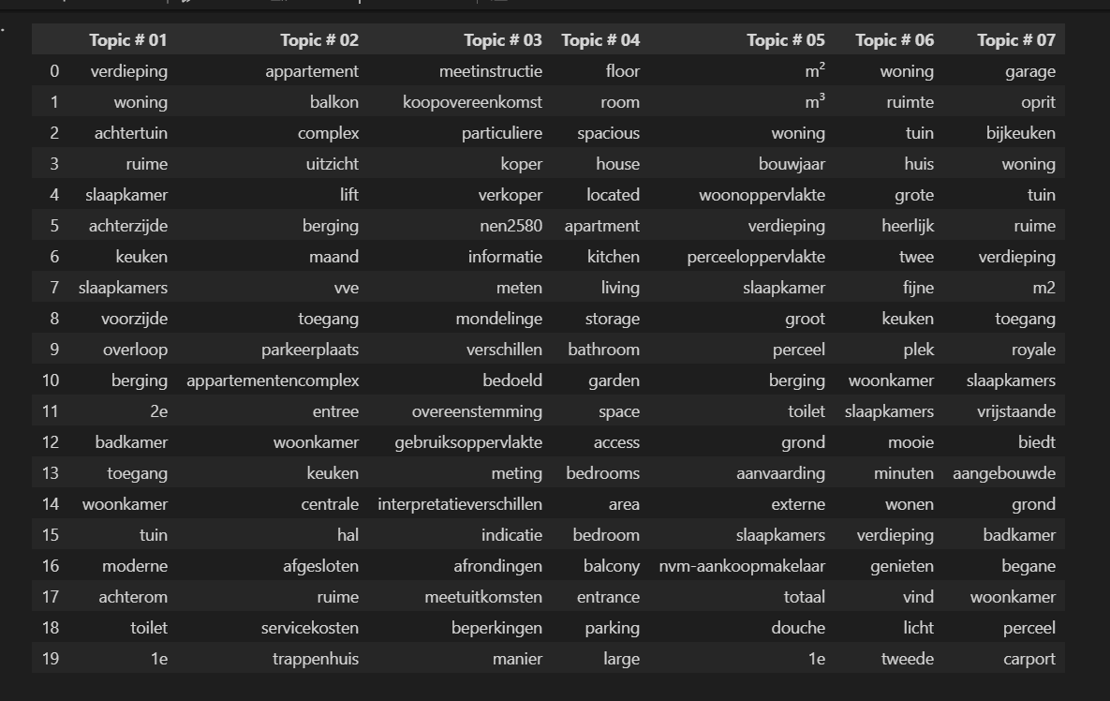
EDA topic modelling
We have used the following columns names for our 7 topics:
1. House properties
2. Facilities
3. Monetary specifications
4. English description
5. Measureable properties
6. Ambiance description
7. Extra's

Slide 6
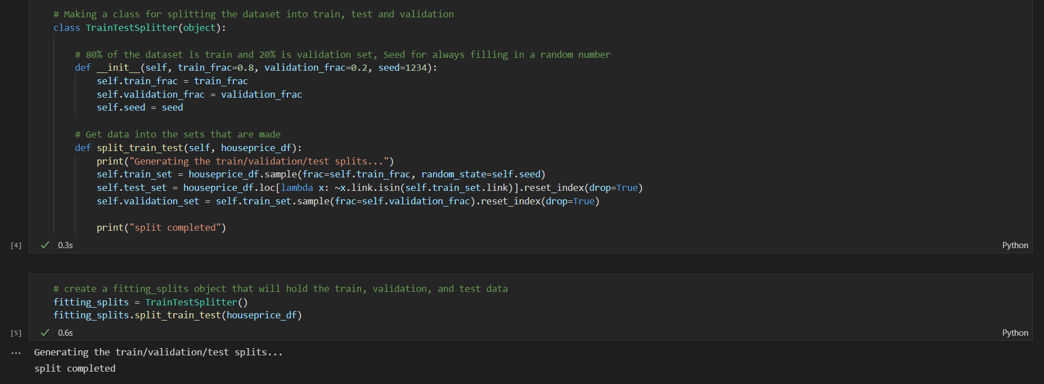
Train/validation/test split

Slide 7
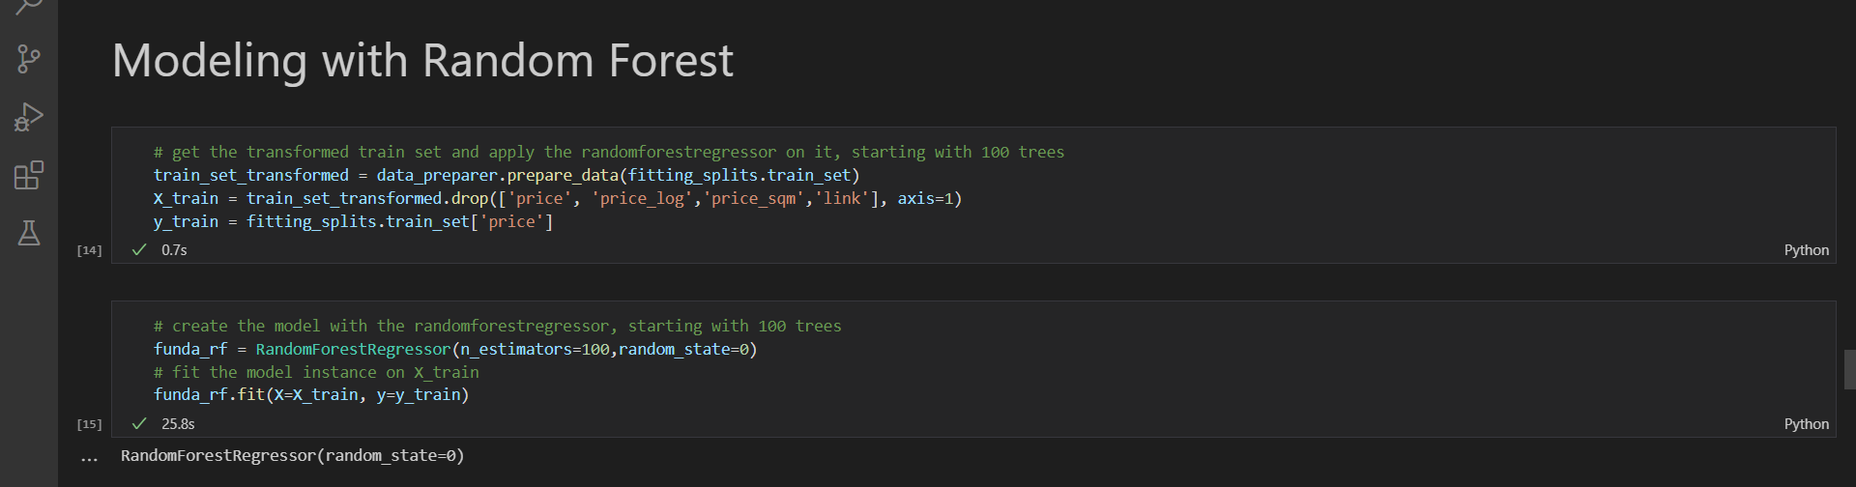
Random forest model

Slide 8
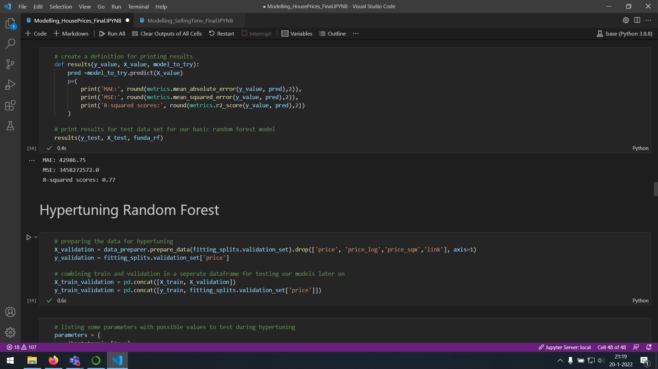
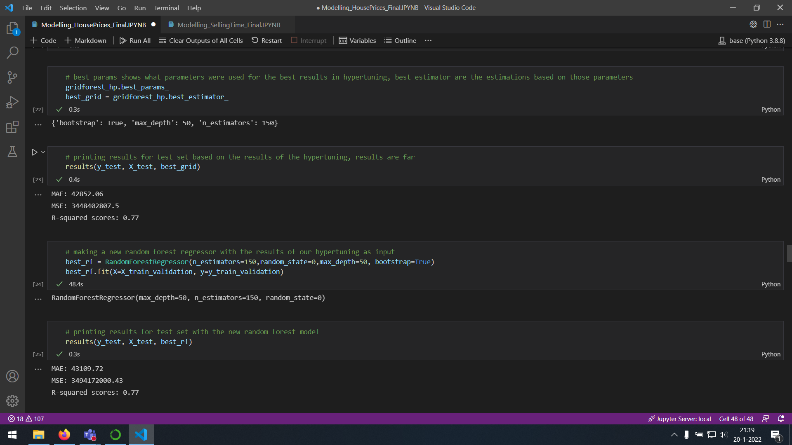
Overall model performance and test predictions

Slide 9
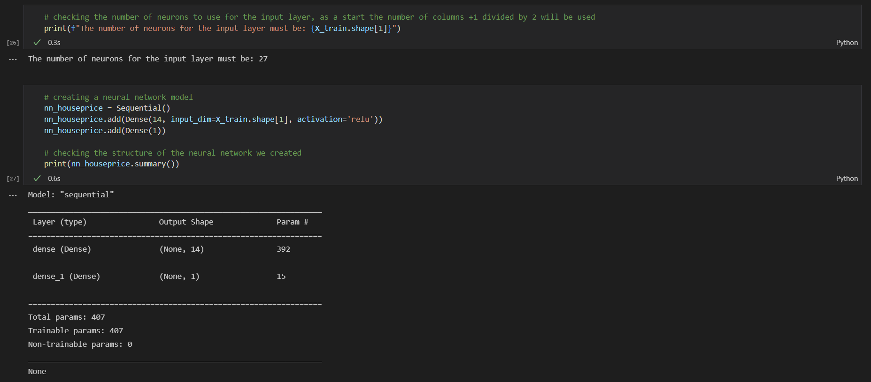
Neural network model

Slide 10
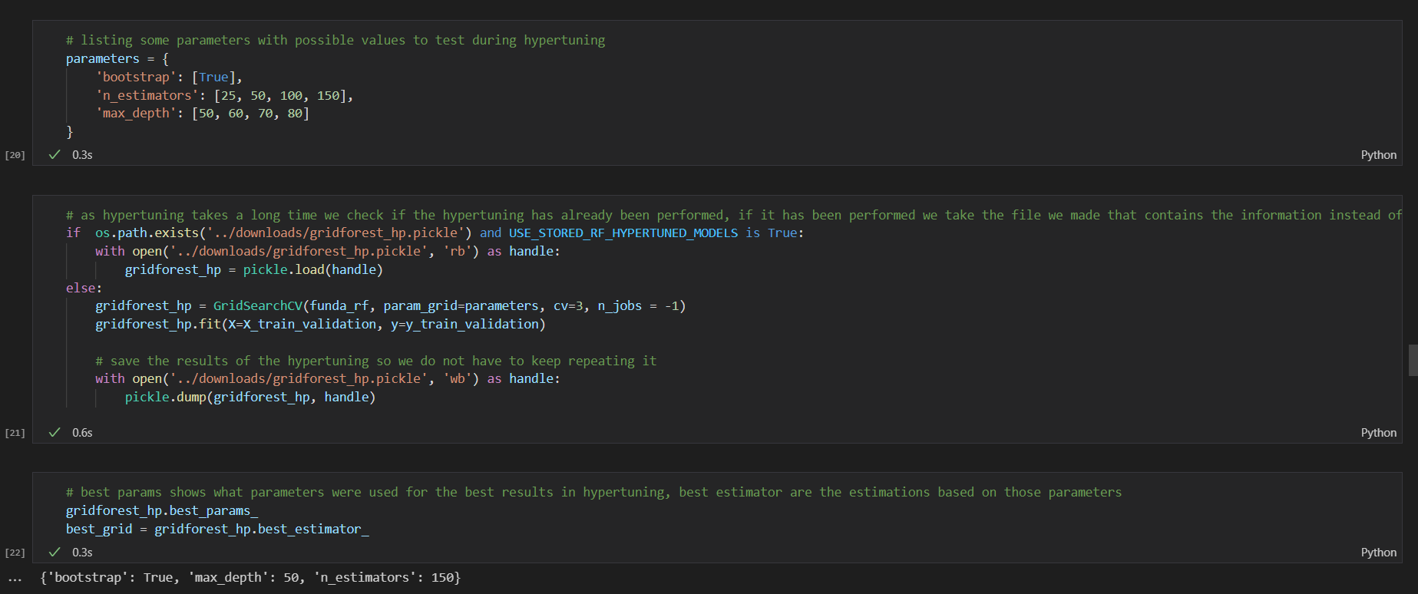
Hyperparameter tuning with grid search

Slide 11
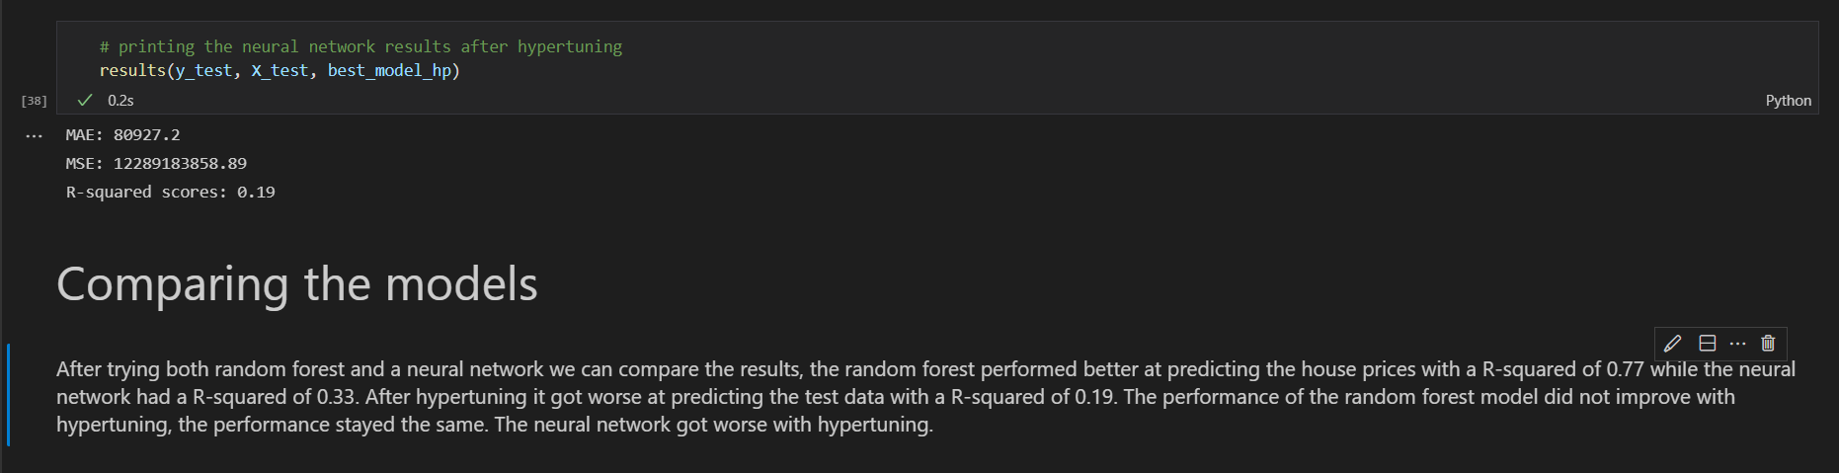
Model comparison

Slide 12
Thank you!

